Slide 1
MyNet is Coming
An Introductory Guide

Slide 2
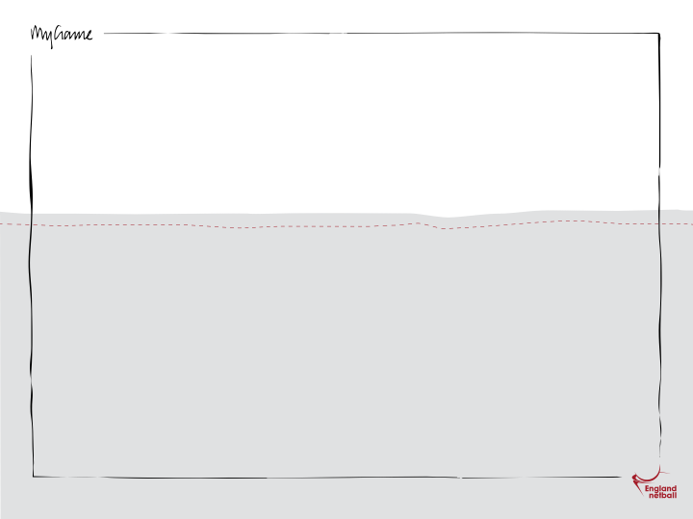
MyNet
England Netball is proud to introduce MyNet; an exciting new system that will be available through a secure login 24 hours a day, 365 days a year.
This fantastic new system will take time to develop and will be launched in stages. First, we need to get the basic administration and data correct, therefore, we will launch the system in June 2012 so affiliations for the 2012/13 year will be entered using MyNet. Then from July 2012, all the new great features will begin to come online. We hope to have all of these installed by March 2013.
Further information and training will be provided on the system in the next few months.

Slide 3
MyNet
MyNet is a comprehensive system that has evolved alongside sporting bodies worldwide and is made from 5 modules:
Contact Zone – centralises EN’s data and includes contact details, security, communication and reporting
Administration Centre - where the game is administered including affiliations, competition and fixture management, officials and match reporting, disciplinary management and statistics
Contact Zone
Administration Centre
Development Core
Elite Hub
Event Line

Slide 4
MyNet
Development Core - the delivery of the grassroots of the game including course and education management, CAPs, club, county and regional websites
Elite Hub which - manages the elite side of Netball and our key athletes including medical and injury history, dietary needs, training, fitness strength and conditioning management and scouting
Event line - manages events including team management and membership & fan clubs
Contact Zone
Administration Centre
Development Core
Elite Hub
Event Line

Slide 5
MyNet
MyNet will mean that members will have access to:
Their data online and will be able to amend/edit some of their data in real time
An online portal with a personalised homepage which will provides relevant information specifically for the member
Sponsors’ offers and discounts
England Netball’s events calendar page & ticket information
Region, County, League, Club directory ie the members handbook online and up to date
News items and special interest forums
Prospective members will also be able to self register prior to affiliation through their club which will mean a reduction in the data the club secretary has to enter.

Slide 6
MyNet
MyNet is a significant investment for England Netball and we have appointed First Sports International (FSI) as the System Provider/Development.
http://www.first-sports.com/
FSI is dedicated solely to the sports market and its unique combination of software development and expertise in sports management has resulted in a comprehensive solution that will dramatically improve our ability to successfully manage and communicate with members, fans, players, officials, coaches, competitions, volunteers, venues, events, ticketing, sponsors, participants and more.

